Slide 1
Redes Neuronales y NLP

Slide 2
Bibliografía
Yoav Goldberg – Neural Network Methods for Natural Language Processing – Morgan & Claypool (2017)

Slide 3
Redes Neuronales ¿Qué son?

Slide 4
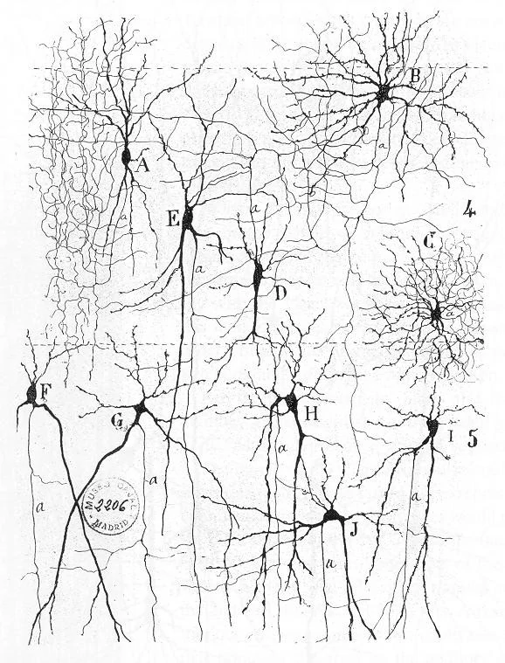
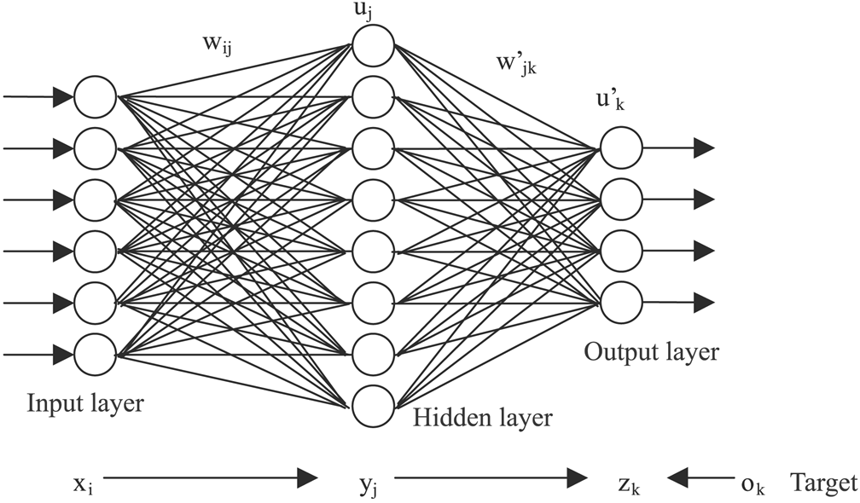
Redes Neuronales ¿Qué son?
Algoritmo de aprendizaje Bio-Inspirado
Fuentes: Biological Neural Networks ,
A Primer on Artificial Neural Networks and Convolutions for Image Data.

Slide 5
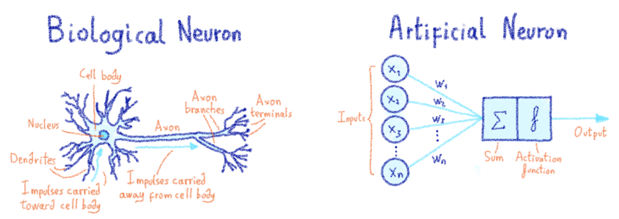
Redes Neuronales ¿Qué son?
Unidad Basica: Neurona/Perceptron
Propuesto por Rosenblatt en 1958
Fuentes:

Slide 6
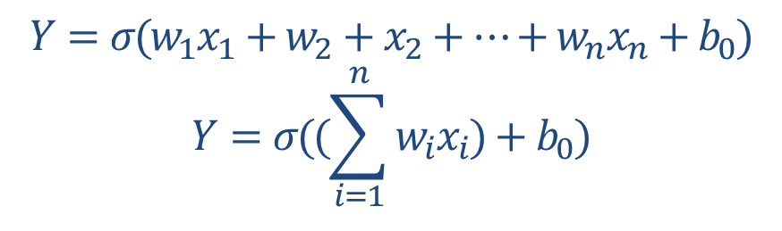
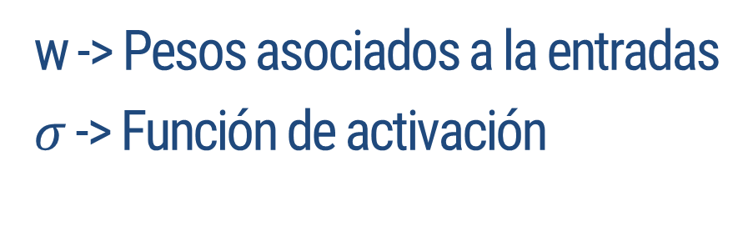
Redes Neuronales ¿Qué son?
Unidad Basica: Neurona/Perceptron
Propuesto por Rosenblatt en 1958
Fuentes:

Slide 7
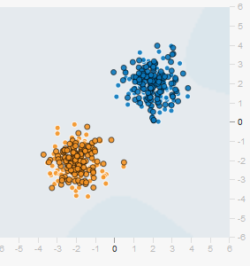
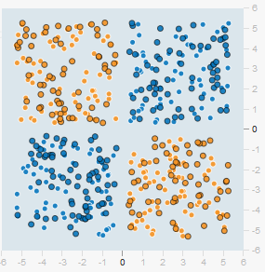
Redes Neuronales ¿Qué son?
Problemas del perceptrón?
El perceptrón funciona bien cuando los datos son linealmente separables
¿Qué podríamos hacer entonces para poder clasificar estos últimos datos?
Fuentes:

Slide 8
Redes Neuronales
Perceptron Multicapa

Slide 9
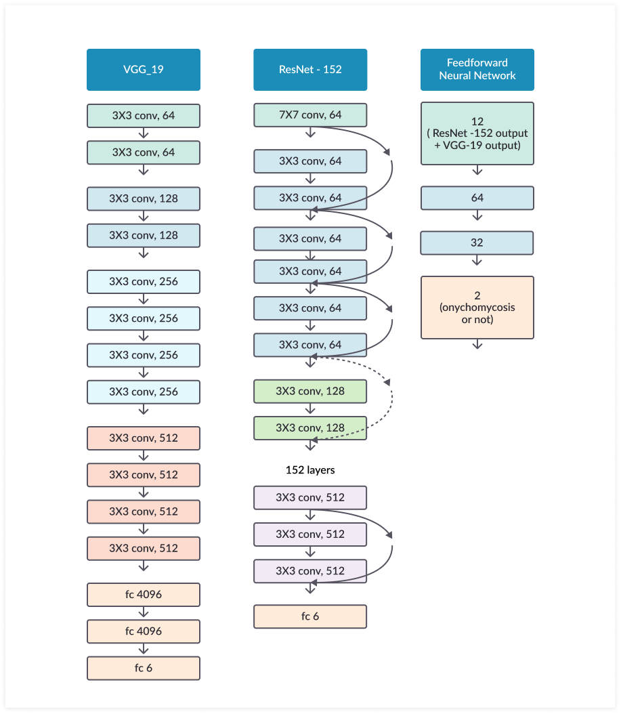
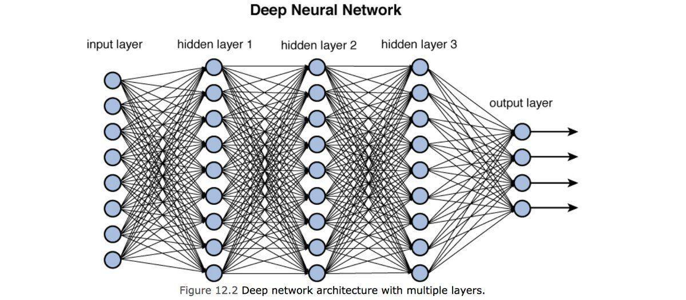
Redes Neuronales
MLP – Deep Learning

Slide 10

Redes Neuronales
Como entrenamos una red - ¿Qué ajustamos?
Las redes son difíciles de entrenar
La idea es ajustar los pesos para aprender (por ej.):
Perro: 0.80
Lobo: 0.10
Reno: 0.09
Gato: 0.01

Slide 11
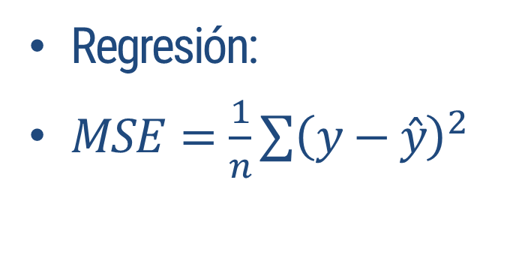
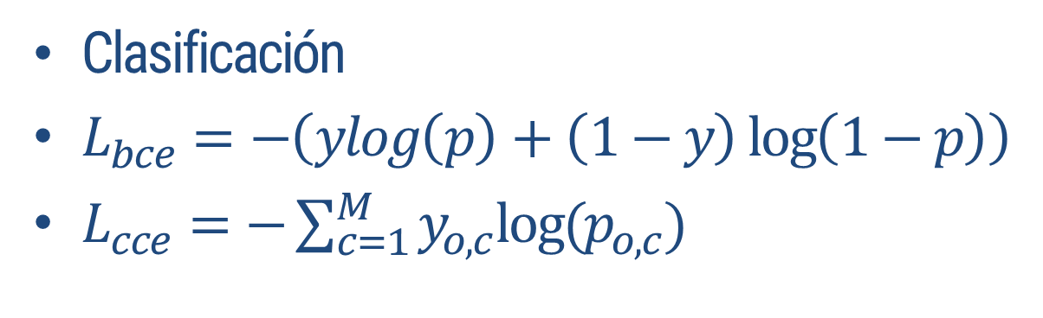
Redes Neuronales
Como entrenamos una red – Función de perdida (Loss function)
Las redes son difíciles de entrenar
La idea es ajustar los pesos para aprender
Minimizando el error (Optimización)
Función de perdida dependiente de nuestro problema:

Slide 12
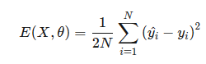
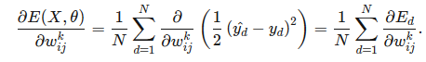
Redes Neuronales
Como entrenamos una red - Backpropagation
Las redes son difíciles de entrenar
La idea es ajustar los pesos para aprender
Minimizando el error (Optimización)
Forward-pass y Backpropagation:
Para una muestra, calculamos el error obtenido (Forward pass)
Propagamos el error hacia atrás, utilizando el algoritmo de Backpropagation

Slide 13
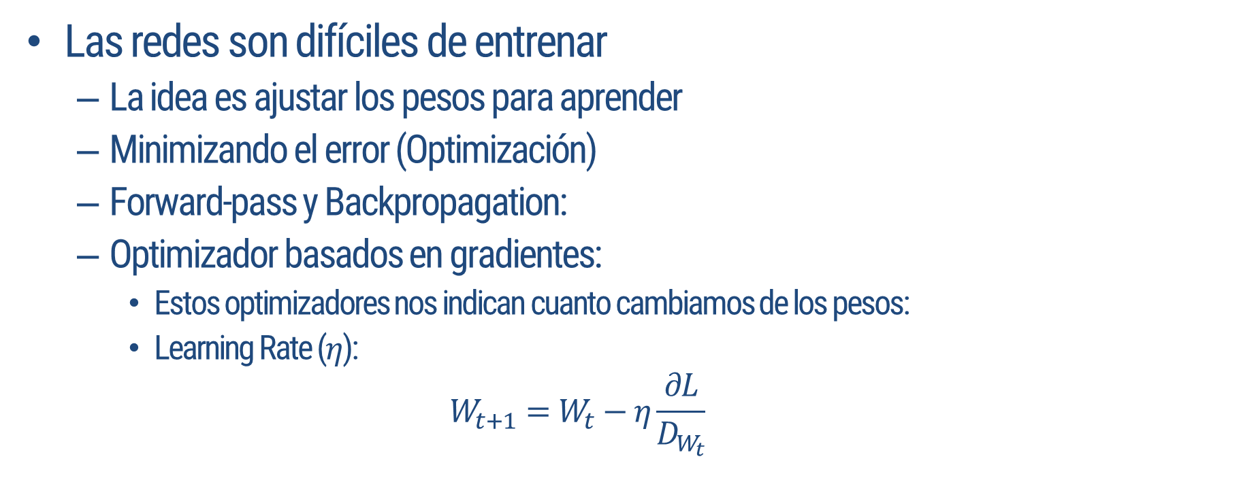
Redes Neuronales
Como entrenamos una red - Optimizadores
Notes:
https://www.benfrederickson.com/numerical-optimization/

Slide 14
Redes Neuronales
Como entrenamos una red - Optimizadores
Las redes son difíciles de entrenar
La idea es ajustar los pesos para aprender
Minimizando el error (Optimización)
Forward-pass y Backpropagation:
Optimizador basados en gradientes:
Estos optimizadores nos indican cuanto cambiamos de los pesos:
Optimizadores Estocásticos: No utilizar todo el set de datos, si no que uno seleccionado al azar de un “mini batch”
Notes:
https://www.benfrederickson.com/numerical-optimization/

Slide 15
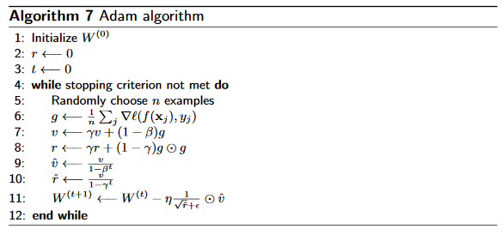
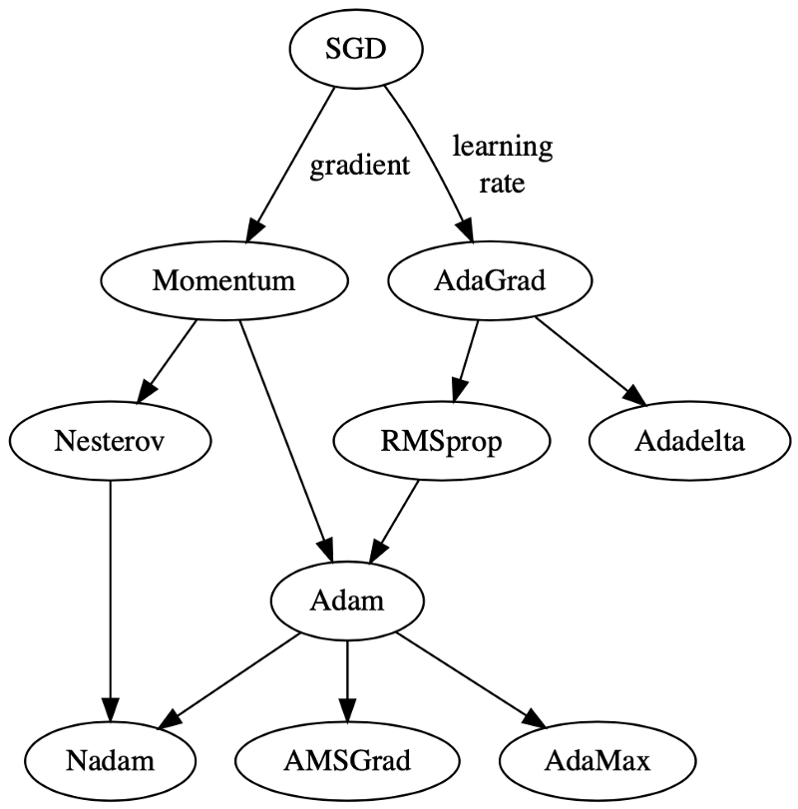
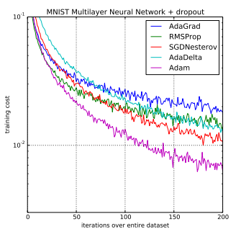
Redes Neuronales
Como entrenamos una red - Optimizadores
Notes:
https://arxiv.org/abs/1412.6980

Slide 16
Redes Neuronales
Como entrenamos una red – Funciones de Activación
Las redes son difíciles de entrenar
La idea es ajustar los pesos para aprender
Minimizando el error (Optimización)
Forward-pass y Backpropagation
Optimizador basados en gradientes
Funciones de Activación:
Notes:
https://www.benfrederickson.com/numerical-optimization/

Slide 17
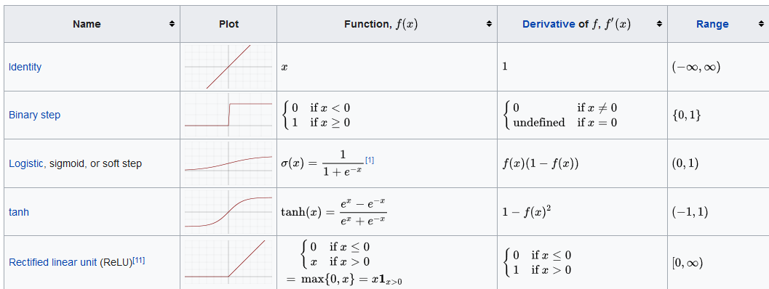
Redes Neuronales
Como entrenamos una red – Funciones de Activación
Notes:
https://en.wikipedia.org/wiki/Activation_function

Slide 18
Redes Neuronales
Como entrenamos una red – Regularización
Las redes son difíciles de entrenar
La idea es ajustar los pesos para aprender
Minimizando el error (Optimización)
Forward-pass y Backpropagation
Optimizador basados en gradientes
Funciones de Activación
Regularización
Notes:
https://www.benfrederickson.com/numerical-optimization/

Slide 19
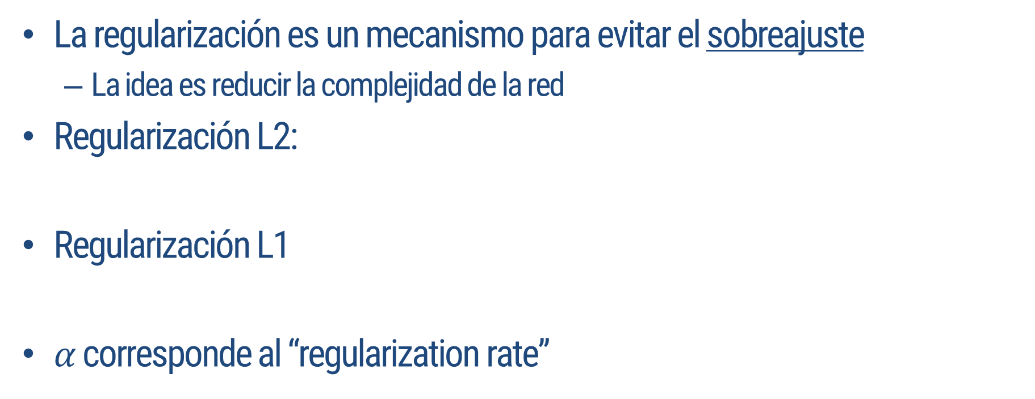
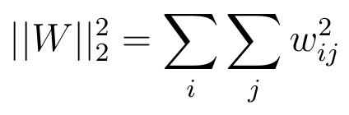
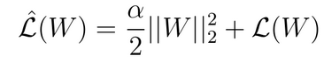
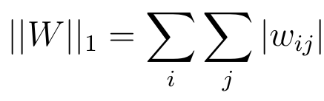
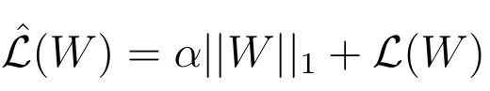
Redes Neuronales
Como entrenamos una red – Regularización
Notes:
L2 Lleva los aproxima a cero
L1 transforma a cero los valores

Slide 20
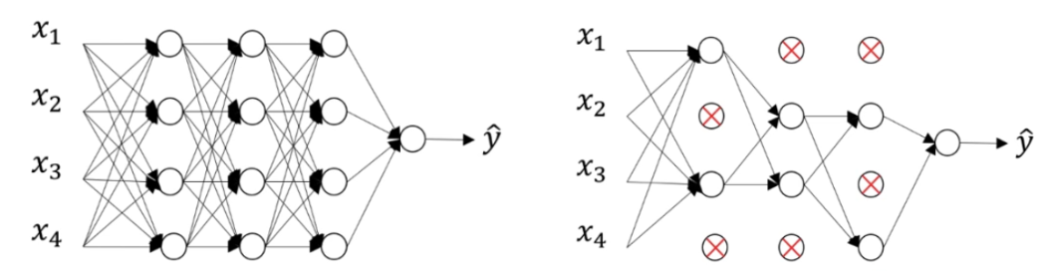
Redes Neuronales
Como entrenamos una red – Regularización
Dropoout
Apagar neuronas bajo una cierta probabilidad
Esto se realiza solo en entrenamiento.
Notes:
L2 Lleva los aproxima a cero
L1 transforma a cero los valores

Slide 21
Redes Neuronales
Como entrenamos una red
Las redes son difíciles de entrenar
La idea es ajustar los pesos para aprender
Minimizando el error (Optimización)
Forward-pass y Backpropagation
Optimizador basados en gradientes
Funciones de Activación
Regularización
Notes:
https://playground.tensorflow.org/

Slide 22
Taxonomia de Redes Neuronales

Slide 23
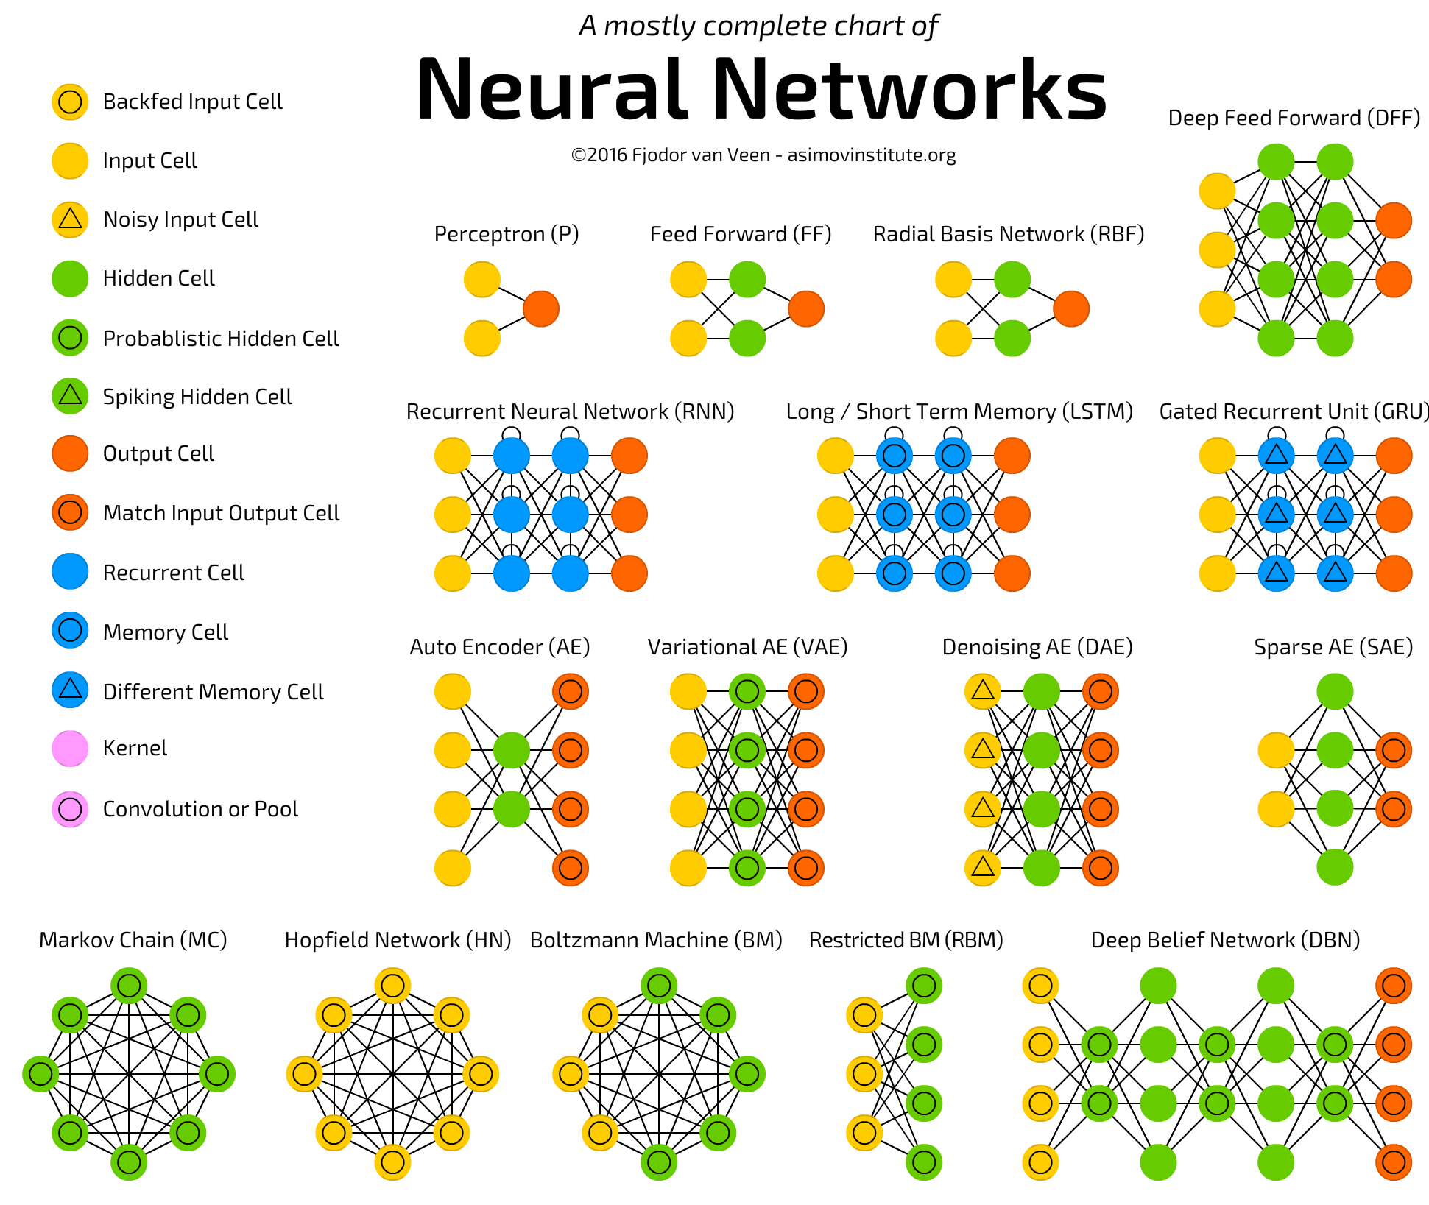
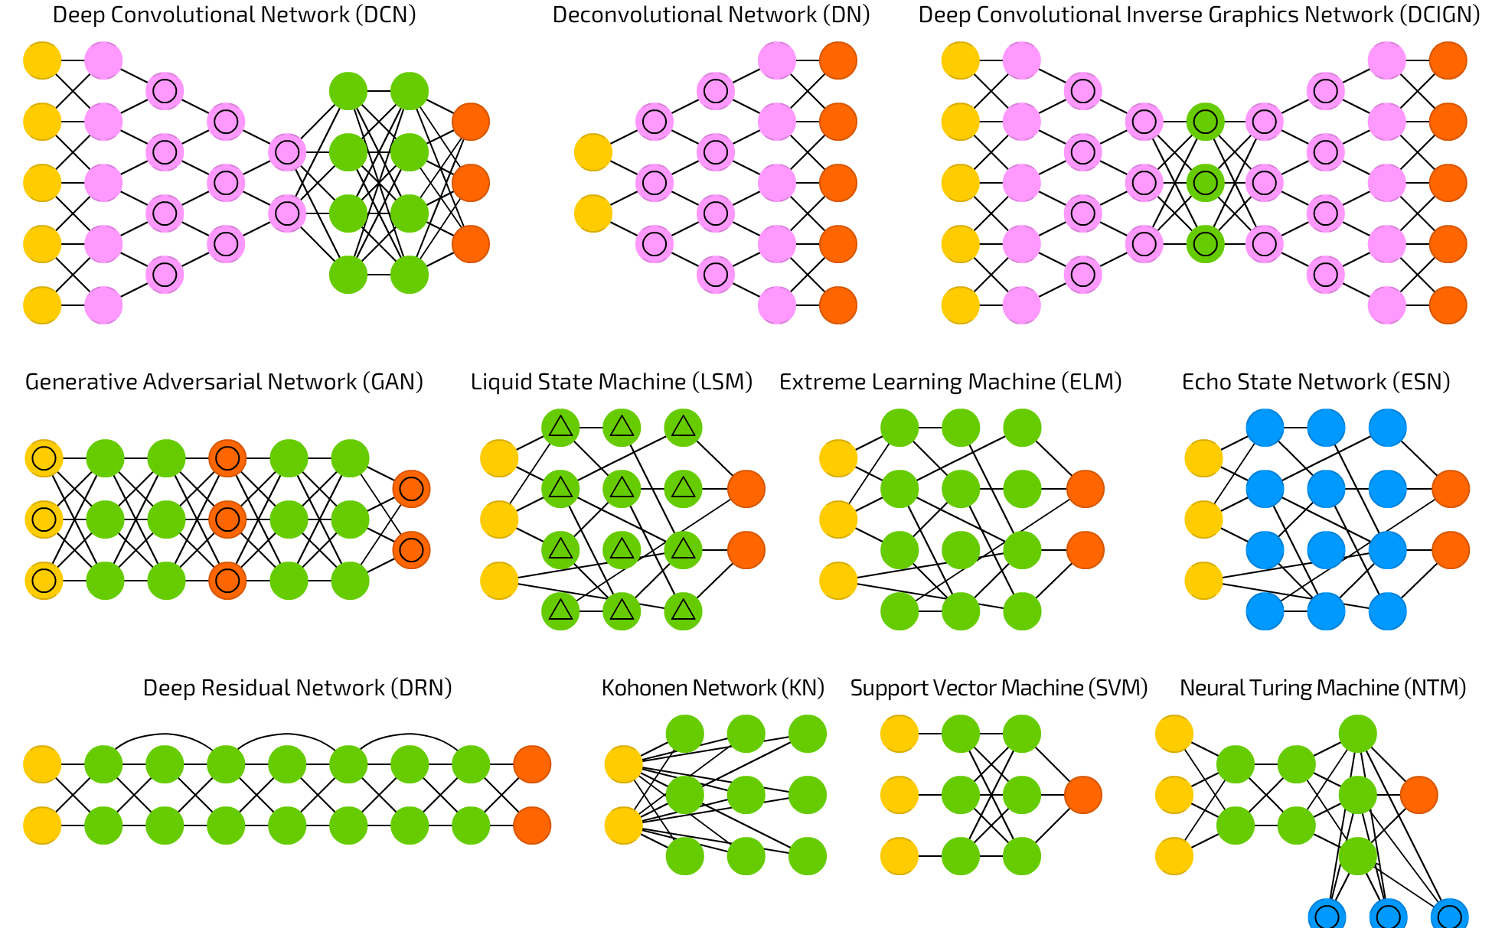
Taxonomía de Redes Neuronales
Múltiples tipos

Slide 24
Taxonomía de Redes Neuronales
Múltiples tipos
Redes Recurrentes
LSTM
GRU
Redes Bidireccionales
Redes Convolucionales
Transformers
BERT

Slide 25
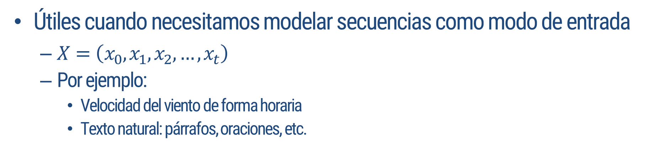
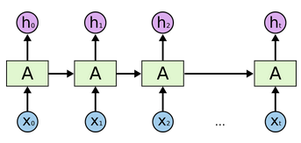
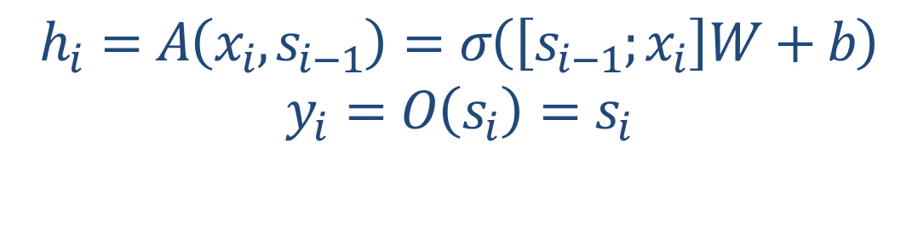
Taxonomía de Redes Neuronales
Redes Recurrentes

Slide 26
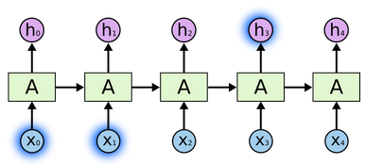
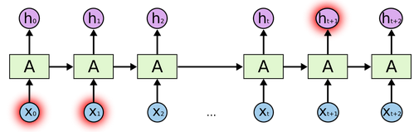
Taxonomía de Redes Neuronales
Redes Recurrentes
Las redes recurrentes simples no están exentas de problemas:
Mucho mas difíciles de entrenar (Backpropragation throught time)
Problemas con dependencias largas:
Notes:
the clouds are in the sky
I grew up in France… I speak fluent French.

Slide 27
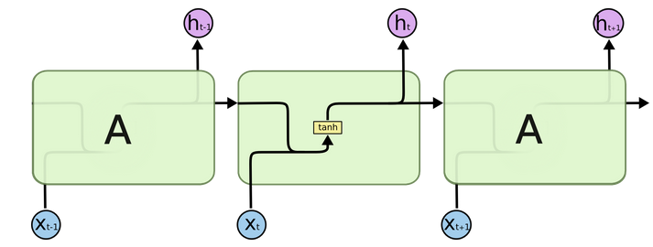
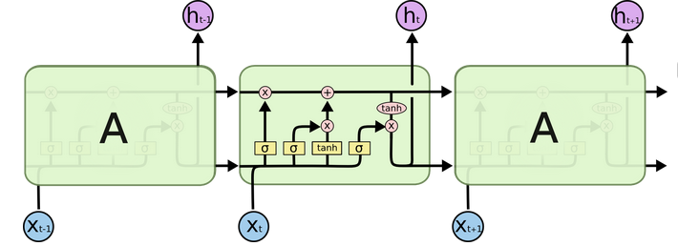
Taxonomía de Redes Neuronales
Redes Recurrentes - LSTM
Una solución: Las Long Short Term Memory cells/networks
Red Recurrente Simple
LSTM
Notes:
https://www.bioinf.jku.at/publications/older/2604.pdf <- Sepp Hochreiter Jürgen Schmidhuber

Slide 28
Taxonomía de Redes Neuronales
Redes Recurrentes - LSTM
Las LSTM incluyen 3 compuertas, y un estado interno de la neurona (no confundir con el estado oculto)
Compuerta de Olvido (Forget Gate)
Compuerta de Entrada (Input Gate)
Compuerta de Salida (Output Gate)
Notes:
the clouds are in the sky
I grew up in France… I speak fluent French.

Slide 29
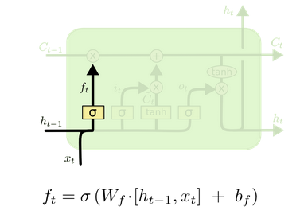
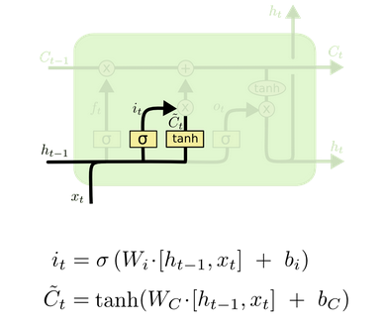
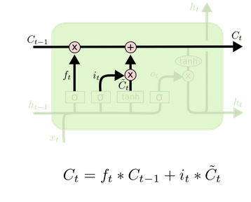
Taxonomía de Redes Neuronales
Redes Recurrentes - LSTM
Una solución: Las Long Short Term Memory cells/networks
Cálculo de la input Gate y estado interno candidato
Cálculo del nuevo estado
Cálculo de la Forget Gate
Notes:
The first step in our LSTM is to decide what information we’re going to throw away from the cell state. This decision is made by a sigmoid layer called the “forget gate layer.” It looks at ht−1 and xt, and outputs a number between 0 and 1 for each number in the cell state Ct−1. A 1 represents “completely keep this” while a 0represents “completely get rid of this.”
Let’s go back to our example of a language model trying to predict the next word based on all the previous ones. In such a problem, the cell state might include the gender of the present subject, so that the correct pronouns can be used. When we see a new subject, we want to forget the gender of the old subject.
The next step is to decide what new information we’re going to store in the cell state. This has two parts. First, a sigmoid layer called the “input gate layer” decides which values we’ll update. Next, a tanh layer creates a vector of new candidate values, C~t, that could be added to the state. In the next step, we’ll combine these two to create an update to the state.
In the example of our language model, we’d want to add the gender of the new subject to the cell state, to replace the old one we’re forgetting.
It’s now time to update the old cell state, Ct−1, into the new cell state Ct. The previous steps already decided what to do, we just need to actually do it.
We multiply the old state by ft, forgetting the things we decided to forget earlier. Then we add it∗C~t. This is the new candidate values, scaled by how much we decided to update each state value.
In the case of the language model, this is where we’d actually drop the information about the old subject’s gender and add the new information, as we decided in the previous steps.

Slide 30
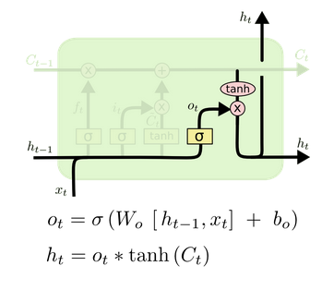
Taxonomía de Redes Neuronales
Redes Recurrentes - LSTM
Una solución: Las Long Short Term Memory cells/networks
Cálculo de la Output Gate y Estado Oculto
Notes:
Finally, we need to decide what we’re going to output. This output will be based on our cell state, but will be a filtered version. First, we run a sigmoid layer which decides what parts of the cell state we’re going to output. Then, we put the cell state through tanh (to push the values to be between −1 and 1) and multiply it by the output of the sigmoid gate, so that we only output the parts we decided to.
For the language model example, since it just saw a subject, it might want to output information relevant to a verb, in case that’s what is coming next. For example, it might output whether the subject is singular or plural, so that we know what form a verb should be conjugated into if that’s what follows next.

Slide 31
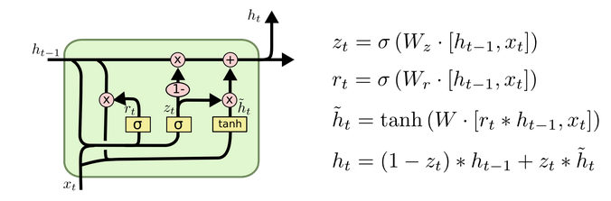
Taxonomía de Redes Neuronales
Redes Recurrentes
Alternativa: Gated Recurrent Unit (GRU)
Notes:
Finally, we need to decide what we’re going to output. This output will be based on our cell state, but will be a filtered version. First, we run a sigmoid layer which decides what parts of the cell state we’re going to output. Then, we put the cell state through tanh (to push the values to be between −1 and 1) and multiply it by the output of the sigmoid gate, so that we only output the parts we decided to.
For the language model example, since it just saw a subject, it might want to output information relevant to a verb, in case that’s what is coming next. For example, it might output whether the subject is singular or plural, so that we know what form a verb should be conjugated into if that’s what follows next.

Slide 32
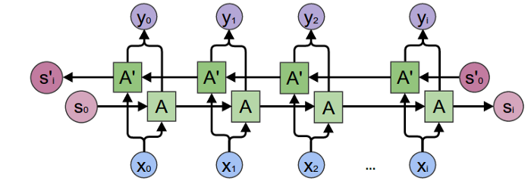
Taxonomía de Redes Neuronales
Redes Recurrentes
Redes Bidireccionales
Utilizamos dos redes recurrentes, para poder ver una secuencia de atrás hacia adelante, y viceversa
Capturando información de ambos lados, usualmente generan mejores representaciones
Notes:
Finally, we need to decide what we’re going to output. This output will be based on our cell state, but will be a filtered version. First, we run a sigmoid layer which decides what parts of the cell state we’re going to output. Then, we put the cell state through tanh (to push the values to be between −1 and 1) and multiply it by the output of the sigmoid gate, so that we only output the parts we decided to.
For the language model example, since it just saw a subject, it might want to output information relevant to a verb, in case that’s what is coming next. For example, it might output whether the subject is singular or plural, so that we know what form a verb should be conjugated into if that’s what follows next.

Slide 33
Taxonomía de Redes Neuronales
Redes Convolucionales
Redes convolucionales:
Desarrolladas para imágenes:
Capa convolucional para extraer características relevantes de imágenes
Pooling para reducir dimensionalidad conservando lo mas importantes de cada características
Notes:
Finally, we need to decide what we’re going to output. This output will be based on our cell state, but will be a filtered version. First, we run a sigmoid layer which decides what parts of the cell state we’re going to output. Then, we put the cell state through tanh (to push the values to be between −1 and 1) and multiply it by the output of the sigmoid gate, so that we only output the parts we decided to.
For the language model example, since it just saw a subject, it might want to output information relevant to a verb, in case that’s what is coming next. For example, it might output whether the subject is singular or plural, so that we know what form a verb should be conjugated into if that’s what follows next.

Slide 34
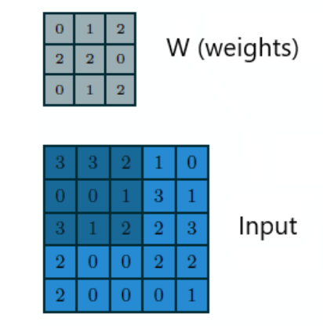
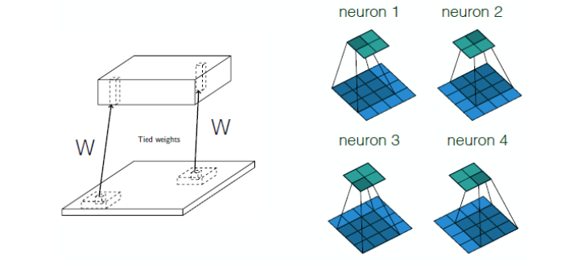
Taxonomía de Redes Neuronales
Redes Convolucionales
Notes:
Finally, we need to decide what we’re going to output. This output will be based on our cell state, but will be a filtered version. First, we run a sigmoid layer which decides what parts of the cell state we’re going to output. Then, we put the cell state through tanh (to push the values to be between −1 and 1) and multiply it by the output of the sigmoid gate, so that we only output the parts we decided to.
For the language model example, since it just saw a subject, it might want to output information relevant to a verb, in case that’s what is coming next. For example, it might output whether the subject is singular or plural, so that we know what form a verb should be conjugated into if that’s what follows next.

Slide 35
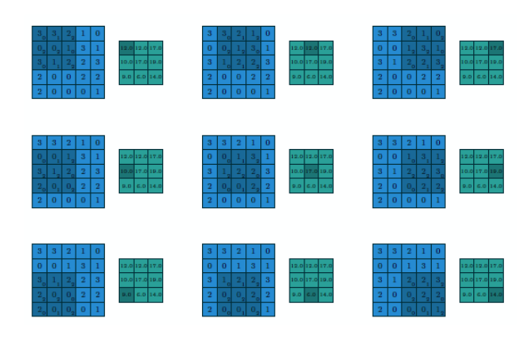
Taxonomía de Redes Neuronales
Redes Convolucionales
Notes:
Finally, we need to decide what we’re going to output. This output will be based on our cell state, but will be a filtered version. First, we run a sigmoid layer which decides what parts of the cell state we’re going to output. Then, we put the cell state through tanh (to push the values to be between −1 and 1) and multiply it by the output of the sigmoid gate, so that we only output the parts we decided to.
For the language model example, since it just saw a subject, it might want to output information relevant to a verb, in case that’s what is coming next. For example, it might output whether the subject is singular or plural, so that we know what form a verb should be conjugated into if that’s what follows next.

Slide 36
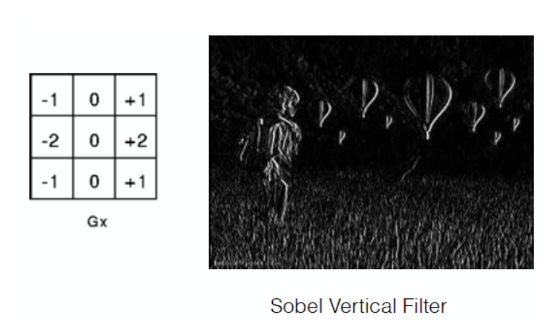
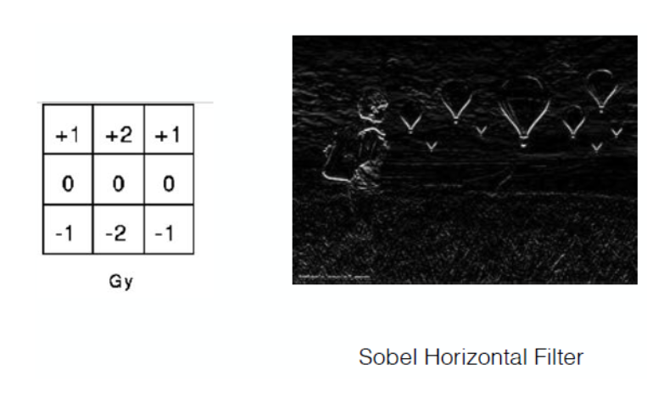
Taxonomía de Redes Neuronales
Redes Convolucionales – Filtros (Kernels)
Notes:
Finally, we need to decide what we’re going to output. This output will be based on our cell state, but will be a filtered version. First, we run a sigmoid layer which decides what parts of the cell state we’re going to output. Then, we put the cell state through tanh (to push the values to be between −1 and 1) and multiply it by the output of the sigmoid gate, so that we only output the parts we decided to.
For the language model example, since it just saw a subject, it might want to output information relevant to a verb, in case that’s what is coming next. For example, it might output whether the subject is singular or plural, so that we know what form a verb should be conjugated into if that’s what follows next.

Slide 37
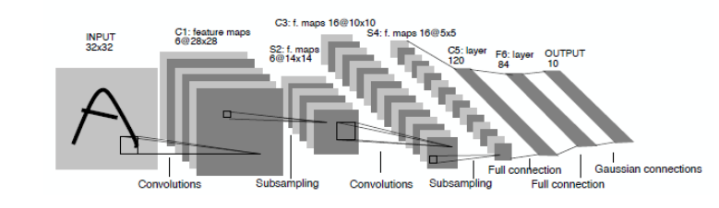
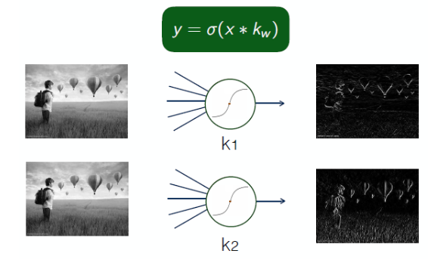
Taxonomía de Redes Neuronales
Redes Convolucionales
Notes:
Finally, we need to decide what we’re going to output. This output will be based on our cell state, but will be a filtered version. First, we run a sigmoid layer which decides what parts of the cell state we’re going to output. Then, we put the cell state through tanh (to push the values to be between −1 and 1) and multiply it by the output of the sigmoid gate, so that we only output the parts we decided to.
For the language model example, since it just saw a subject, it might want to output information relevant to a verb, in case that’s what is coming next. For example, it might output whether the subject is singular or plural, so that we know what form a verb should be conjugated into if that’s what follows next.

Slide 38
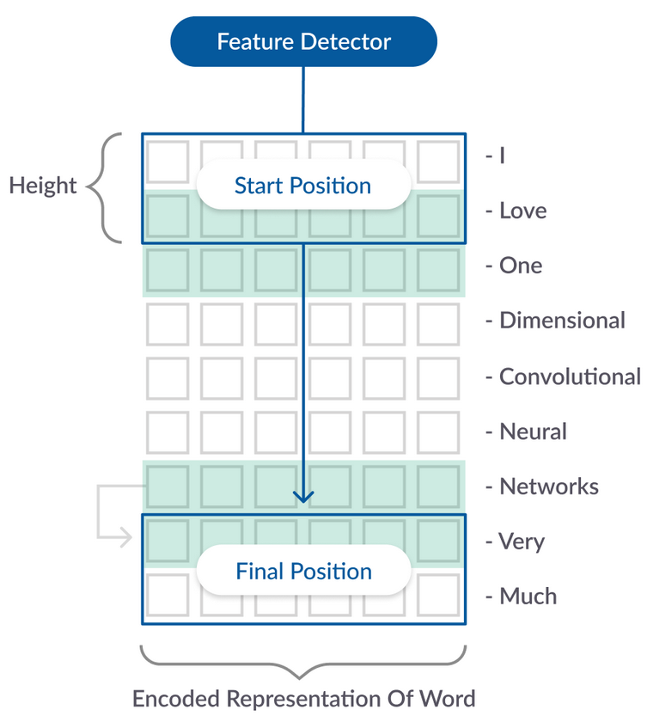
Taxonomía de Redes Neuronales
Redes Convolucionales
Redes convolucionales para texto:
Operar Convoluciones sobre vectores de palabras, específicamente convoluciones 1D
Notes:
Finally, we need to decide what we’re going to output. This output will be based on our cell state, but will be a filtered version. First, we run a sigmoid layer which decides what parts of the cell state we’re going to output. Then, we put the cell state through tanh (to push the values to be between −1 and 1) and multiply it by the output of the sigmoid gate, so that we only output the parts we decided to.
For the language model example, since it just saw a subject, it might want to output information relevant to a verb, in case that’s what is coming next. For example, it might output whether the subject is singular or plural, so that we know what form a verb should be conjugated into if that’s what follows next.

Slide 39
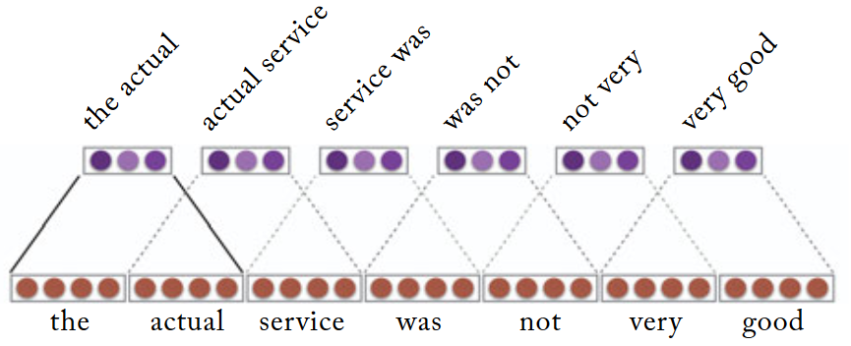
Taxonomía de Redes Neuronales
Redes Convolucionales
Redes convolucionales para texto:
Los vectores generados son combinaciones entre los vectores de palabras.
Notes:
Finally, we need to decide what we’re going to output. This output will be based on our cell state, but will be a filtered version. First, we run a sigmoid layer which decides what parts of the cell state we’re going to output. Then, we put the cell state through tanh (to push the values to be between −1 and 1) and multiply it by the output of the sigmoid gate, so that we only output the parts we decided to.
For the language model example, since it just saw a subject, it might want to output information relevant to a verb, in case that’s what is coming next. For example, it might output whether the subject is singular or plural, so that we know what form a verb should be conjugated into if that’s what follows next.

Slide 40
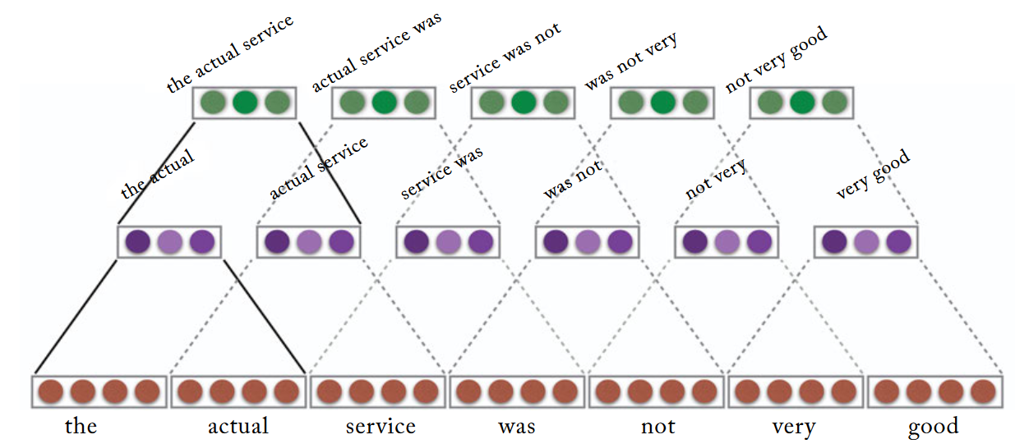
Taxonomía de Redes Neuronales
Redes Convolucionales
Redes convolucionales para texto:
Podemos tener múltiples convoluciones para obtener estructuras jerárquicas
Notes:
Finally, we need to decide what we’re going to output. This output will be based on our cell state, but will be a filtered version. First, we run a sigmoid layer which decides what parts of the cell state we’re going to output. Then, we put the cell state through tanh (to push the values to be between −1 and 1) and multiply it by the output of the sigmoid gate, so that we only output the parts we decided to.
For the language model example, since it just saw a subject, it might want to output information relevant to a verb, in case that’s what is coming next. For example, it might output whether the subject is singular or plural, so that we know what form a verb should be conjugated into if that’s what follows next.

Slide 41
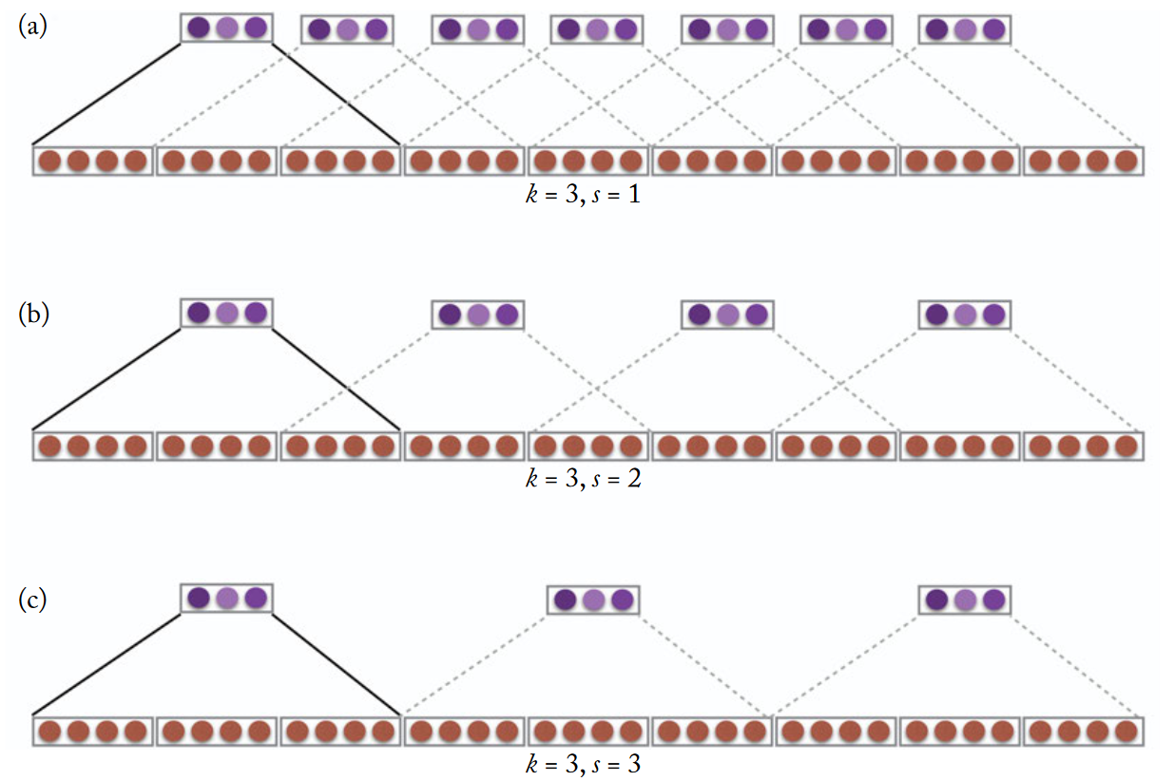
Taxonomía de Redes Neuronales
Redes Convolucionales
Redes convolucionales para texto:
Con el parámetro stride, podemos ir saltando representaciones
Notes:
Finally, we need to decide what we’re going to output. This output will be based on our cell state, but will be a filtered version. First, we run a sigmoid layer which decides what parts of the cell state we’re going to output. Then, we put the cell state through tanh (to push the values to be between −1 and 1) and multiply it by the output of the sigmoid gate, so that we only output the parts we decided to.
For the language model example, since it just saw a subject, it might want to output information relevant to a verb, in case that’s what is coming next. For example, it might output whether the subject is singular or plural, so that we know what form a verb should be conjugated into if that’s what follows next.

Slide 42
Taxonomía de Redes Neuronales
Experimentos prácticos con Redes Neuronales
Practica de LSTM y CNN en Google Colab
Lectura de datos
Generar nuestras primeras redes
Utilizar vectores pre-entrenados
Ejercicios:
Impacto de la cantidad de datos para entrenar
Aplicar Preprocesamiento
Variar las estructuras de las redes

Slide 43

Taxonomía de Redes Neuronales
Transformers
Una arquitectura reciente, ha tomado el mundo por sorpresa: Transformers propuestos en el paper: “Attention is all you need”
Presenta una arquitectura compuesta por redes feedforward y mecanismos de atención
Notes:
the clouds are in the sky
I grew up in France… I speak fluent French.

Slide 44

Taxonomía de Redes Neuronales
Transformers - Preliminares
Preliminares: Arquitectura Encoder-Decoder
Dos redes recurrentes la cual una codifica los datos de entrada, y el decoder, los decodifica a una nueva salida.
Ej: Traducción automatizada
Encoder
Decoder
Notes:
the clouds are in the sky
I grew up in France… I speak fluent French.

Slide 45


Taxonomía de Redes Neuronales
Transformers - Preliminares
Notes:
https://distill.pub/2016/augmented-rnns/

Slide 46

Taxonomía de Redes Neuronales
Transformers

Slide 47


BERT
Aplicaciones de Transformers
Bidirectional Encoder Representations from Transformers
Propuesto el 2019 por Devlin et al.

Slide 48

BERT
Aplicaciones de Transformers
110 Millones de parámetros la versión base.
BERT-Large: 340
Entrenados con BookCorpus y todo Wikipedia en Inglés, 1 millón de iteraciones
Útil para hacer Transfer Learning:

Slide 49
BERT
Aplicaciones de Transformers
Practico de BERT – Google Colab
Hacer ajuste fino en un set de datos en inglés de análisis de sentimiento
Utilizar pytorch para esto
Definir el loop de entrenamiento y de pruebas
Modificar la arquitectura de bert para nuestras necesidades
Ejercicio:
Hacer la comparación en el tamaño de la muestra de entrenamiento para ver el rendimiento

Slide 50


NLP
Tareas
Clasificación de Documentos:
Identificación del lenguaje
Clasificación de Tópicos
Atribución de Autoria
Palabras en Contexto:
Part Of Speech Tagging
Reconocimiento de entidades con nombres
Desambiguación de preposiciones
Relaciones entre palabras en un contexto:
“Dependency Parsing”
Notes:
Purpose
Beneficiary
Duration
Location

Slide 51
NLP
Democraticación del NLP
Últimamente ha existido un crecimiento en popularidad en el NLP
Hay gente que lo atribuye a que vivimos un evento similar a Imagenet y las arquitecturas de redes Convolucionales
En este caso, serian los transformers los que permitieron este salto fuerte debido a las arquitecturas pre-entrenadas
Existen esfuerzos en la comunidad por Democratizar las tecnologías de NLP:
https://huggingface.co/ <- Modelos pre-entrenados para distintas arquitecturas
https://datasets.quantumstat.com/ <- Repositorios de set de datos
https://paperswithcode.com/ <- Códigos de implementaciones “State of the art”
Notes:
Purpose
Beneficiary
Duration
Location

Slide 52
Redes Neuronales y NLP ¿Preguntas?

